Slide 1
Agricultural Productivity & Rainfall Analysis
Data-Driven Insights from National Rainfall and Crop Yield Trends (1966-2014)
Presented by: Joy Myers

Slide 2
Primary Objective: To analyze the long-term national relationship between monsoon rainfall and major crop yields (Rice and Wheat) to identify the key drivers of productivity growth.
Period of Study | 1966 - 2014
Key Metrics | Monsoon Rainfall (mm, Jun-Sep), Rice Yield (Kg per ha), Wheat Yield (Kg per ha).

Slide 3
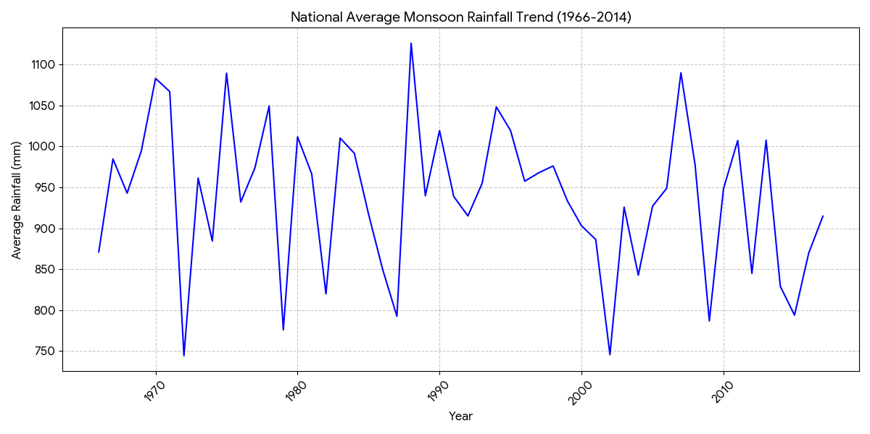
Rainfall Pattern Analysis (National Trend)
Key Finding:
National average monsoon rainfall shows high year-to-year volatility but no significant long-term increasing or decreasing trend over the nearly five-decade period.
A time-series plot showing the annual average monsoon rainfall across all subdivisions. Highlights periods of extreme drought/high rainfall.

Slide 4
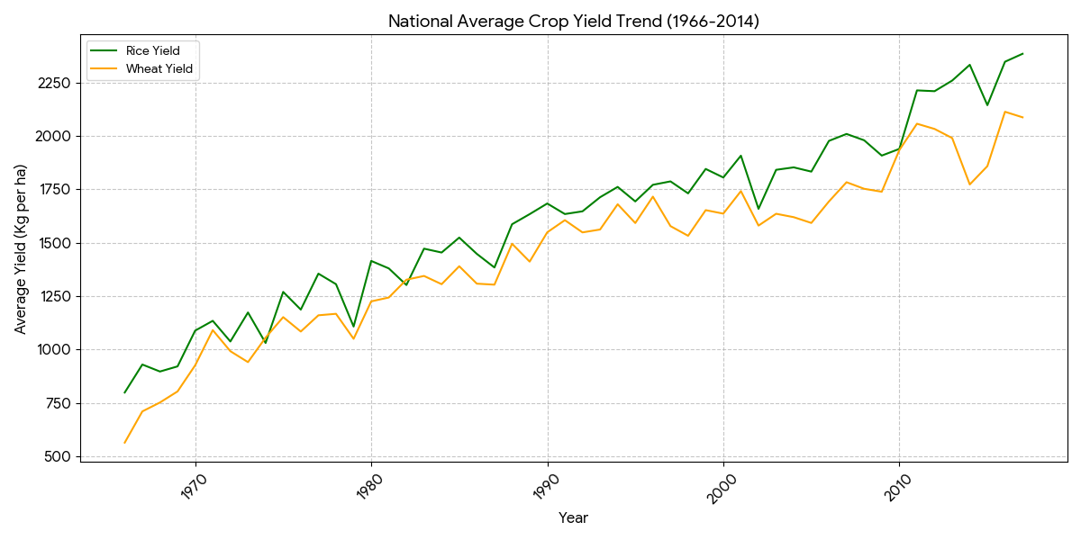
Agricultural Productivity Trend
Key Finding:
Both Rice and Wheat yields show a strong, consistent, and significant positive growth trend from 1966 to 2014, a hallmark of the Green Revolution and subsequent agricultural improvements.
A time-series plot comparing the national average yield for Rice and Wheat. The plot visually confirms the decoupled, upward trajectory of productivity.

Slide 5
The Rainfall-Productivity Correlation
Metric | Correlation with National Monsoon Rainfall | Interpretation
Rice Yield | -0.0869 | Very weak negative correlation. Rainfall is not a strong predictor of long-term national yield growth.
Wheat Yield | -0.0870 | Very weak negative correlation. The trend in Wheat yield is largely independent of national rainfall patterns.
Conclusion | This weak correlation suggests that non-rain factors (e.g., irrigation, technology adoption, High Yielding Varieties, fertilizers) are the dominant drivers of agricultural productivity increases over this period.
Core Insight:
At the national level, average monsoon rainfall is not the primary driver of the observed long-term yield growth.

Slide 6
Regional Performance
Top 5 States: Average Rice Yield | Avg. Yield (Kg per ha) | Top 5 States: Average Monsoon Rainfall | Avg. Rainfall (mm)
Punjab | 3100.42 | Kerala | 1916.86
Tamil Nadu | 2813.90 | Assam | 1613.04
Andhra Pradesh | 2337.55 | West Bengal | 1599.58
Haryana | 2188.08 | Karnataka | 1422.71
Karnataka | 2151.54 | Orissa | 1123.70
Key Finding:
States with the highest yields do not necessarily overlap with states receiving the highest monsoon rainfall, reinforcing the importance of localized irrigation and infrastructure.

Slide 7
Conclusion & Strategic Recommendations
Section | Content
Conclusion | National agricultural productivity growth (Rice & Wheat) is robustly driven by technological and infrastructural advancements, minimizing the dependence on average monsoon rainfall at the macro level.
Recommendations | 1. Focus on Irrigation: Invest in modern, efficient irrigation techniques (e.g., drip, pivot) in high-yield states like Punjab and Haryana to secure output against local rainfall deficits.
 | 2. Local Analysis: Future analysis should focus on district-level correlations and the impact of rainfall timing (e.g., specific month correlation) to provide targeted, actionable advice for individual crop cycles.
 | 3. Mitigate Volatility: Prioritize resilience strategies in high-rainfall volatility states (identified on Slide 3) to protect average yields from monsoon failures.

